Slide 1


Innovative project | 5ISS INSA Toulouse 2021-2022
SAFE CITY FOR CYCLISTS!
Final Presentation

Slide 2
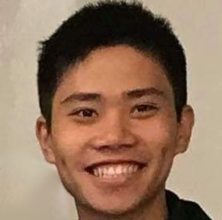
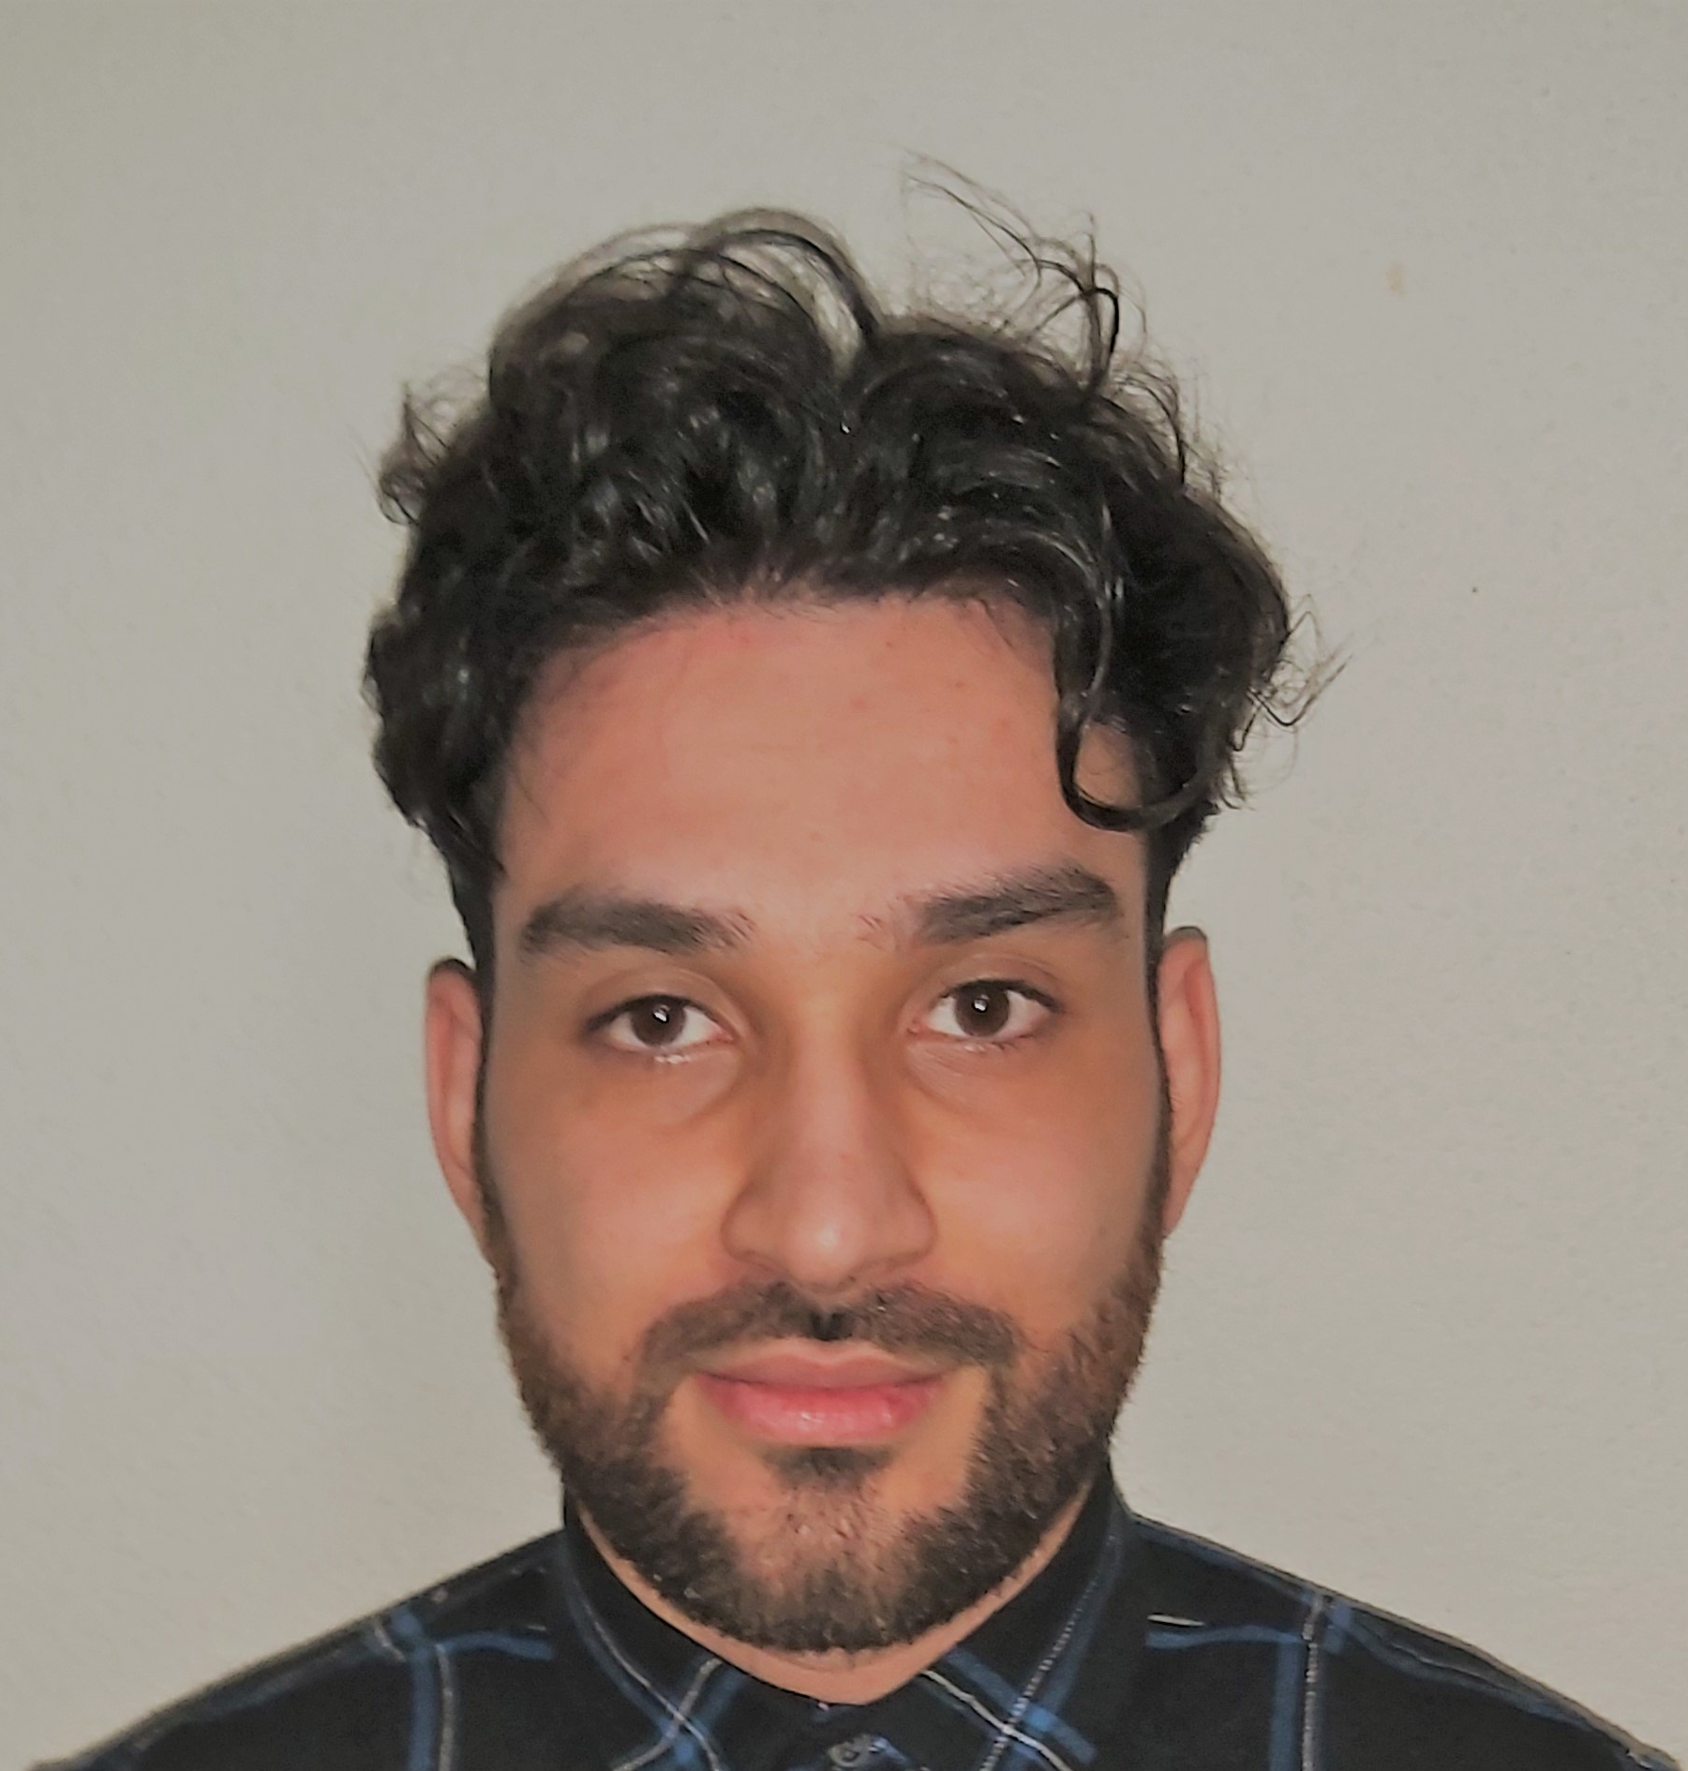
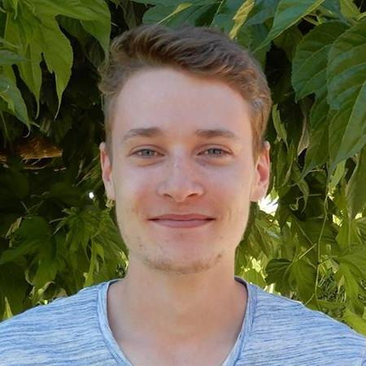

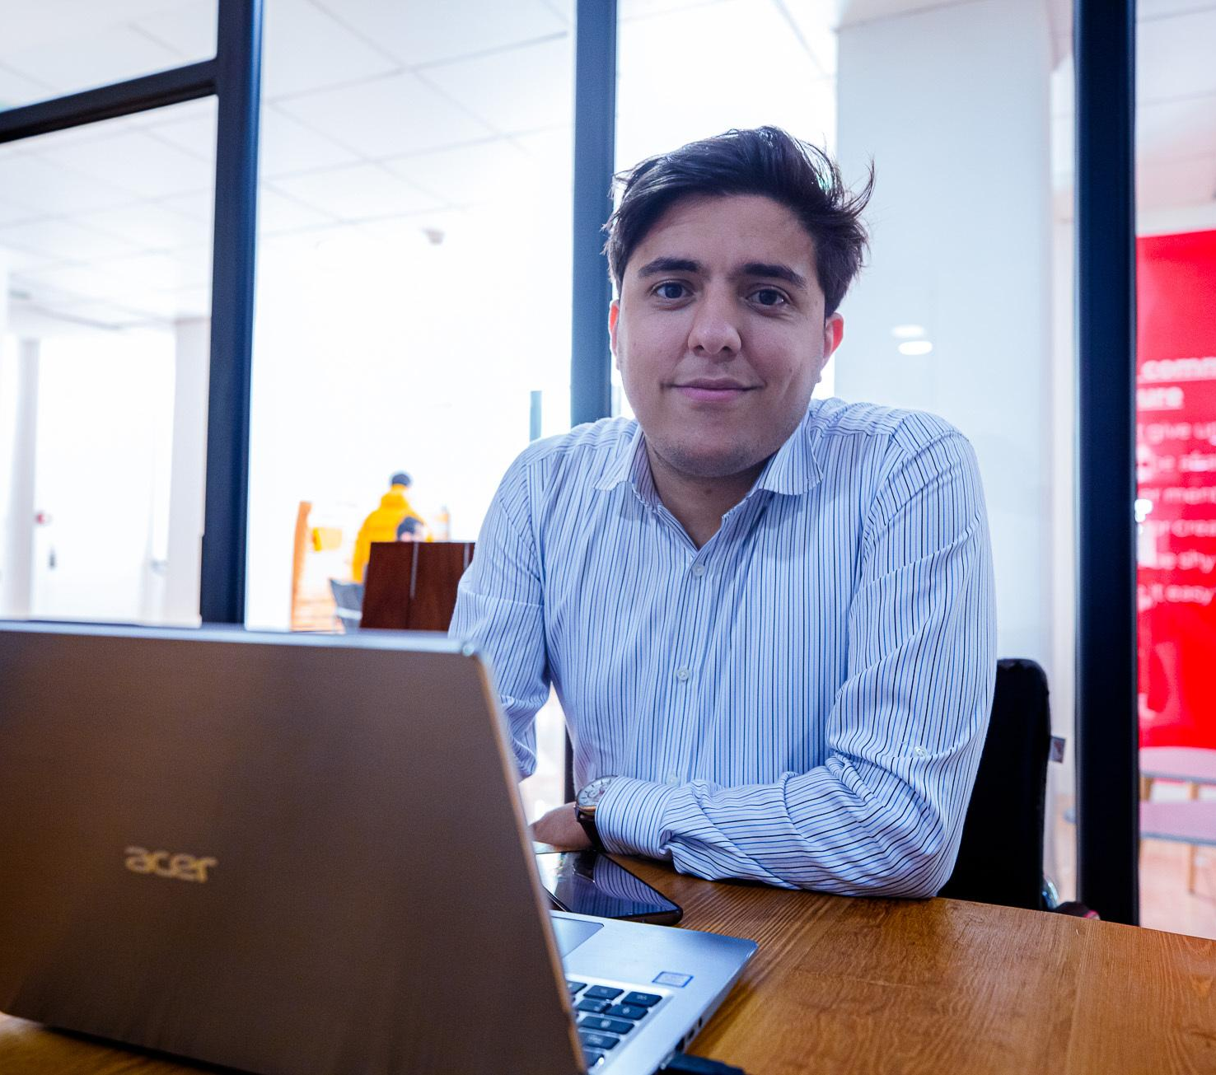
SAFE CITY FOR CYCLISTS
Jean-Rémy Hok Server and Mobile app
Networking and Computer Science student
Aymen Boukezzata Hardware and embedded software
Electronics and Automation student
Arnaud Vergnet TEAM LEADER
Mobile app
Networking and Computer Science student
Thomas Berton Hardware and embedded software
Electronics and Automation student
Mohamed Arselan Meslouh Hardware and embedded software
Advanced Master in IoT student

Slide 3
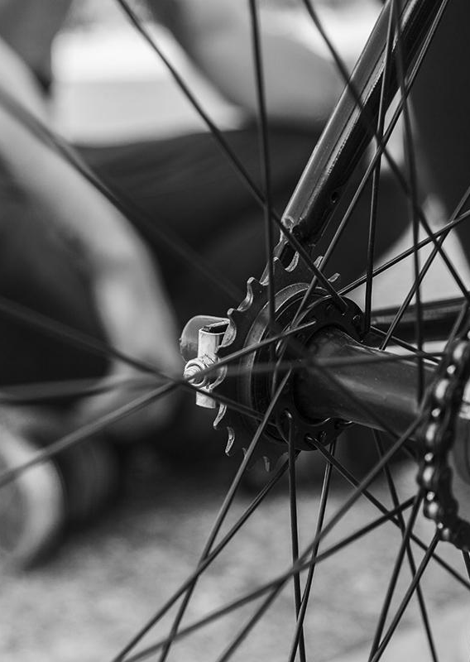
Outline
General Idea
General Architecture
Final Result
Conclusion
Live Demo

Slide 4
I. General Idea II. General Architecture III. Final Result IV. Conclusion V. Live Demo
General Idea
01
02
03
Arnaud
Users bike around the city with our device on their bike
This data is displayed on a map to help detect dangerous areas
The device detects vehicles passing too close and too fast
Notes:
Here is the principle of our project:
User bike around the city will be equipped with our device
The device will collect different data to detect and calculate the speed of vehicle passing too close or too fast
Those data will be sent on our map app to help detect dangerous area

Slide 5


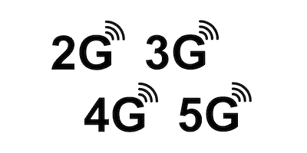
I. General Idea II. General Architecture III. Final Result IV. Conclusion V. Live Demo
General Architecture
Arselan
Notes:
Expliquer pourquoi. Quels pb amènent a telle solution

Slide 6
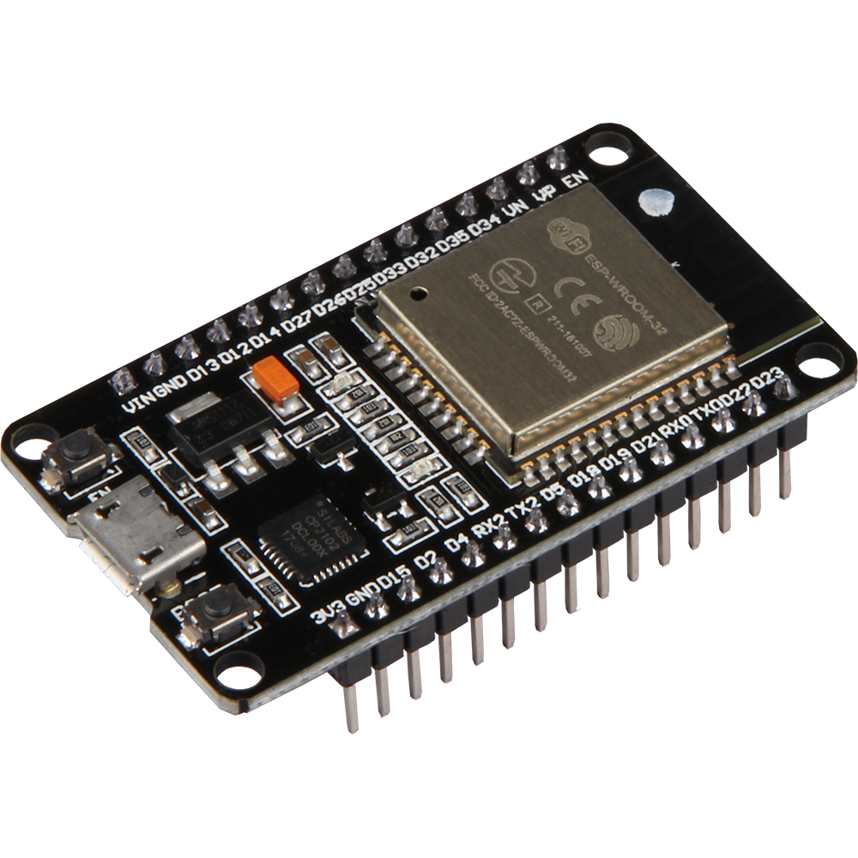

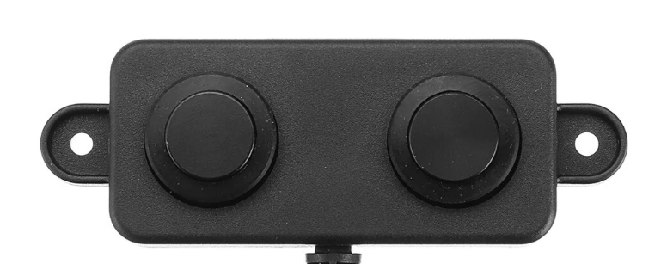
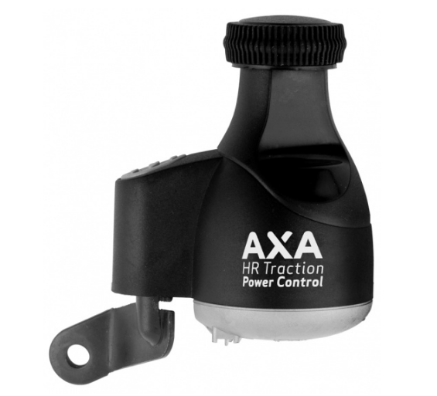

I. General Idea II. General Architecture III. Final Result I V. Conclusion V. Live Demo
Final Result: Hardware
Arselan
ESP32
LIDAR sensors placed at both ends of the bike (for the speed and distance)
Notes:
Our system is composed of an ESP32 microcontroller, and two ultrasonic sensors which will be place at the frond and the rear of the bike. The goal of those sensors is to measure the speed of a vehicule which will approach the bike. And then this data will be collected and users will be able to upload it in our map app.

Slide 7
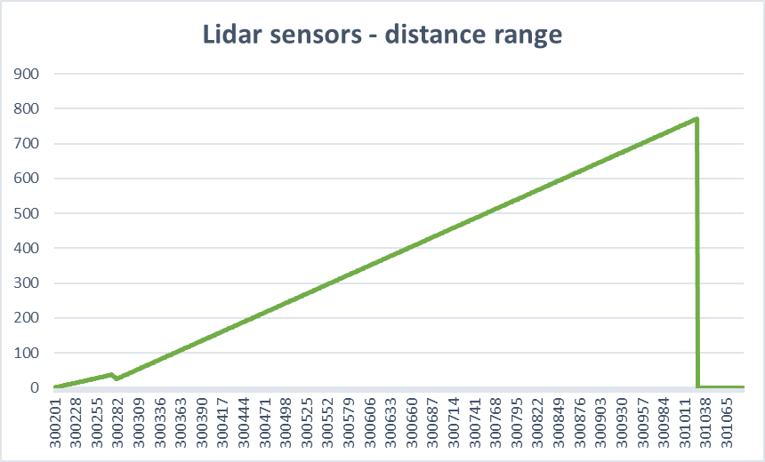
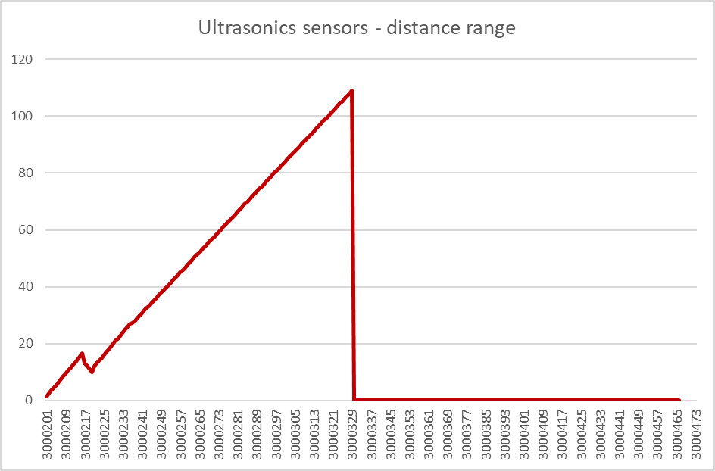
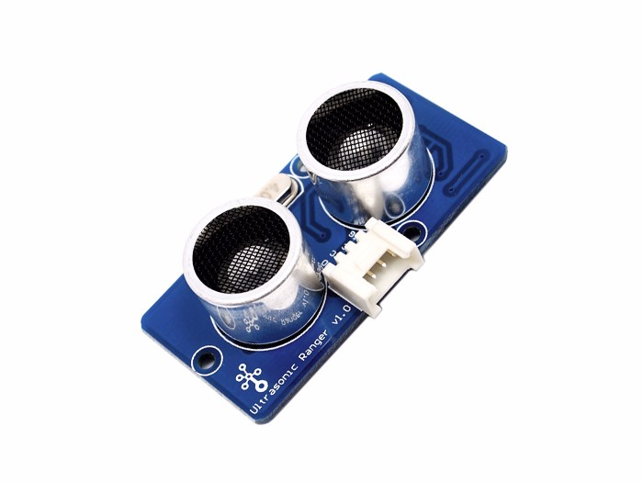
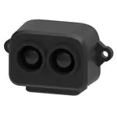



I. General Idea II. General Architecture III. Final Result I V. Conclusion V. Live Demo
Final Result: Distance Sensor
Thomas
LIDAR sensors
Ultrasonic sensors
Main characteristics:
Maximum detection 8m with 99% of accuracy
0.2m - 8m at 90% of reflectivity
0.2m - 2.5m at 10% of reflectivity
Affordable (around 25€ retail price)
Filter the data by limiting the range to 3m with hardware registers
The maximum range is 108cm
The maximum range is 8 meters
Communication with I2C

Slide 8
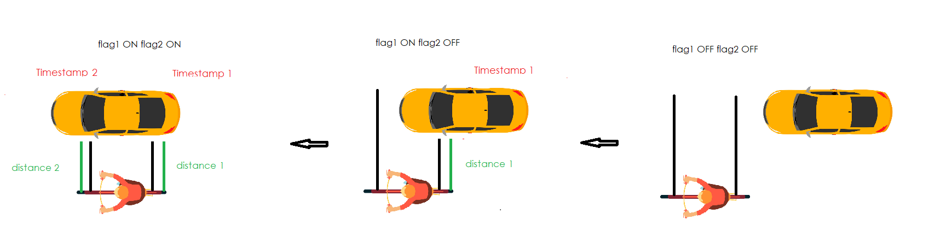
I. General Idea II. General Architecture III. Final Result I V. Conclusion V. Live Demo
Final Result: Speed Measure Algorithm
03
02
01
Thomas
Speed = Distance (between the sensors) eeeeeeeeTimestamp2 - Timestamp1

Slide 9
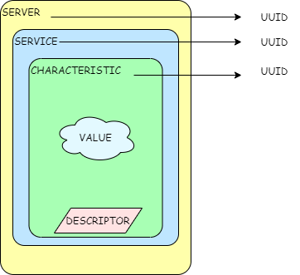


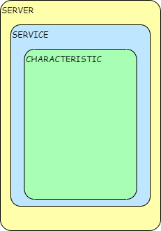

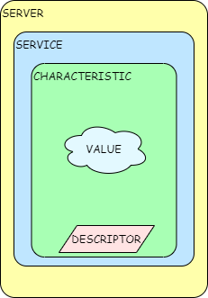

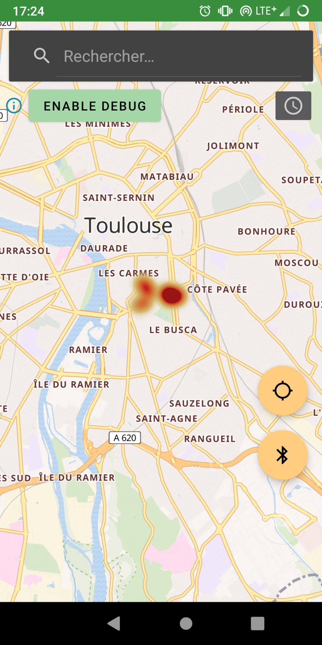
I. General Idea II. General Architecture III. Final Result I V. Conclusion V. Live Demo
Final Result: BLE communication
Arselan
Notes:
Our system is composed of an ESP32 microcontroller, and two ultrasonic sensors which will be place at the frond and the rear of the bike. The goal of those sensors is to measure the speed of a vehicule which will approach the bike. And then this data will be collected and users will be able to upload it in our map app.

Slide 10
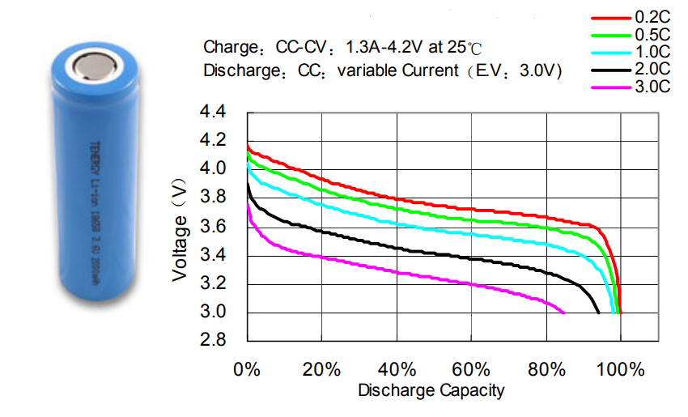
I. General Idea II. General Architecture III. Final Result I V. Conclusion V. Live Demo
Final Result: Power Supply
Aymen
Main characteristics to be provided
Li-Ion Battery
Boost the voltage to 5V
Maintain the voltage throughout the life of the battery
Battery protection
Optimize the battery life
Notes:
Our system is embedded in a bicycle. Therefore, to ensure its autonomy, it must be powered by an energy storage unit (battery). fore this porpose, we used a lithium-ion battery.

Slide 11
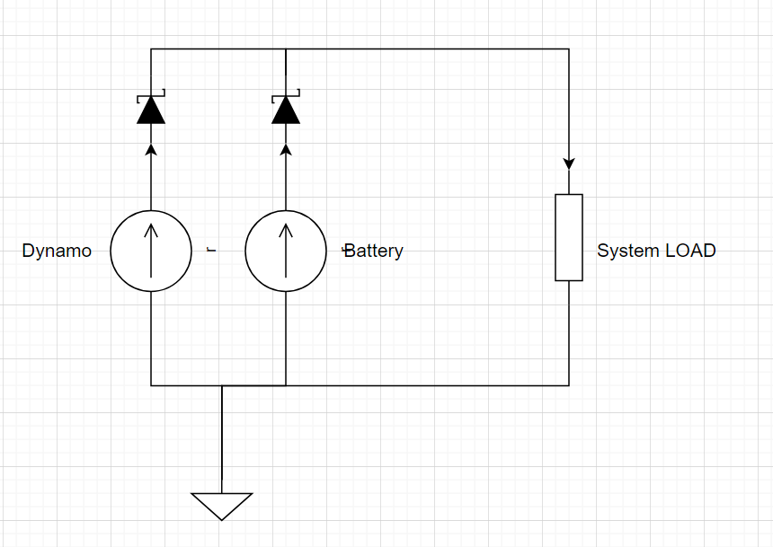
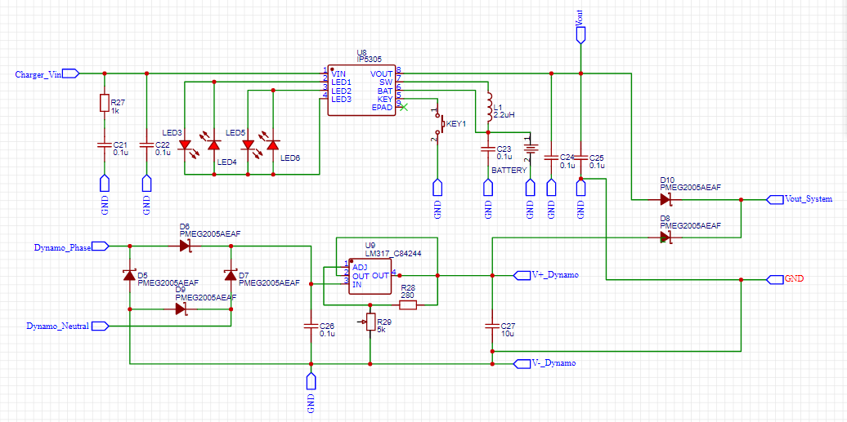
I. General Idea II. General Architecture III. Final Result I V. Conclusion V. Live Demo
Final Result: Full Power Supply System
Aymen
Our needs
Battery + Dynamo system
Notes:
So first we need a battery to power the system. Although the bike can generate electrical energy from electromagnetic induction, we used a dynamo to optimize the energy consumption of the battery.

Slide 12
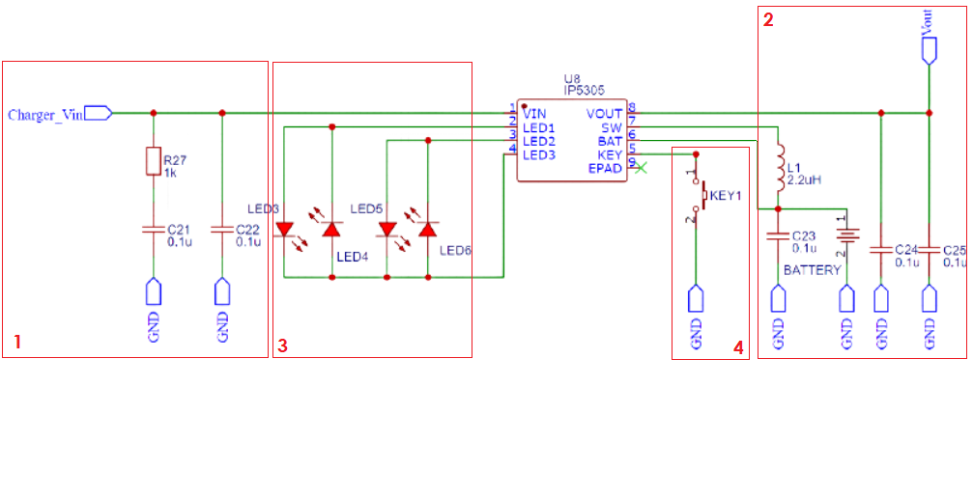
I. General Idea II. General Architecture III. Final Result I V. Conclusion V. Live Demo
Final Result: Battery Power Management
Aymen
Main characteristics to be provided
IP5305 IC
5V input battery charger
90% efficiency synchronous boost converter
4 LED battery status indicator
Smart load to switch off the system when consumption is under 100 uA

Slide 13

I. General Idea II. General Architecture III. Final Result I V. Conclusion V. Live Demo
Final Result: Battery Power Management
Aymen
Main Features
IP5305 IC
5V input battery charger
Protection against over charging
4 LED battery status indicator
Smart load to switch off the system when consumption is under 100 uA
90% efficiency synchronous boost converter
Notes:
For the Battery Power Management I used IP5305 IC which has the following main characteristics

Slide 14
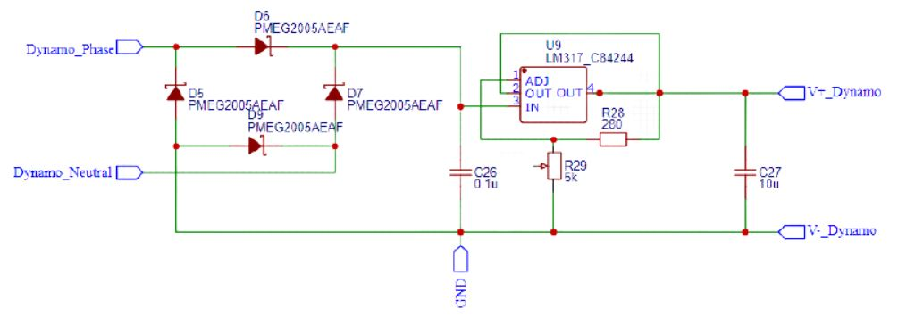
I. General Idea II. General Architecture III. Final Result I V. Conclusion V. Live Demo
Final Result: Dynamo
Aymen
Main characteristics to be provided
Dynamo
Full bridge rectifier at the input
Low-dropout regulator (LM317 IC)
Variable command for the regulator

Slide 15
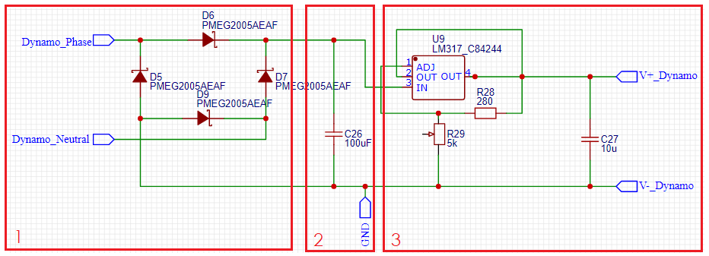
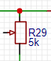
I. General Idea II. General Architecture III. Final Result I V. Conclusion V. Live Demo
Final Result: Dynamo
Aymen
Main characteristics to be provided
Dynamo
Potentiometer to adjust the output voltage
Full bridge rectifier at the input
Filter the rectified Signal
Low-dropout regulator (LM317 IC)

Slide 16
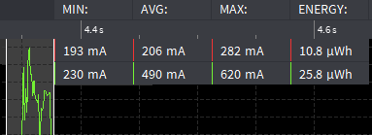
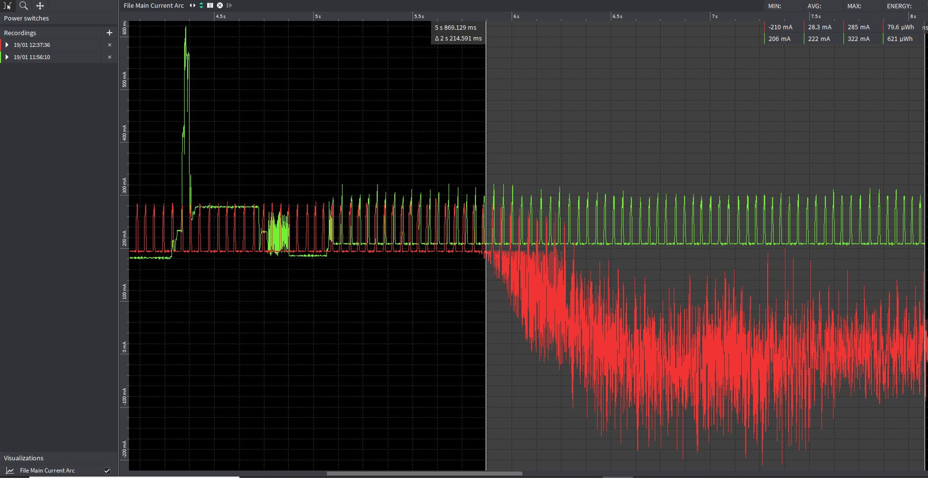
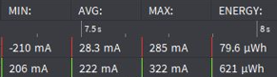
I. General Idea II. General Architecture III. Final Result I V. Conclusion V. Live Demo
Final Result: Power Consumption
Aymen
ESP32 + 2 LIDAR
ESP32 + 2 LIDAR + Dynamo
87.2%
Notes:
Power consumption -> first thing to notice -> pedaling

Slide 17




I. General Idea II. General Architecture III. Final Result I V. Conclusion V. Live Demo
Final Result: Application
Arnaud
Android app written in
OpenStreetMap Map data (Open database)
Geoapify Map tiles, routing and place search
MapLibre Android map renderer

Slide 18
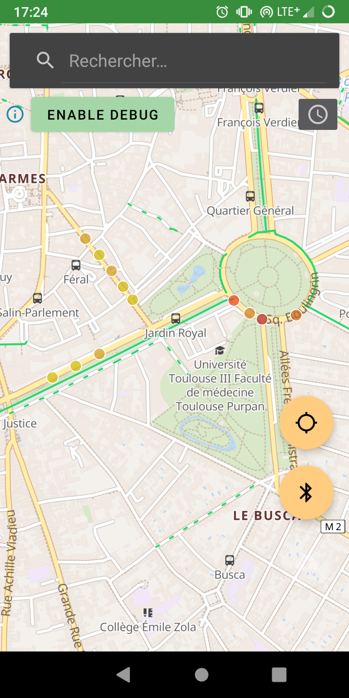
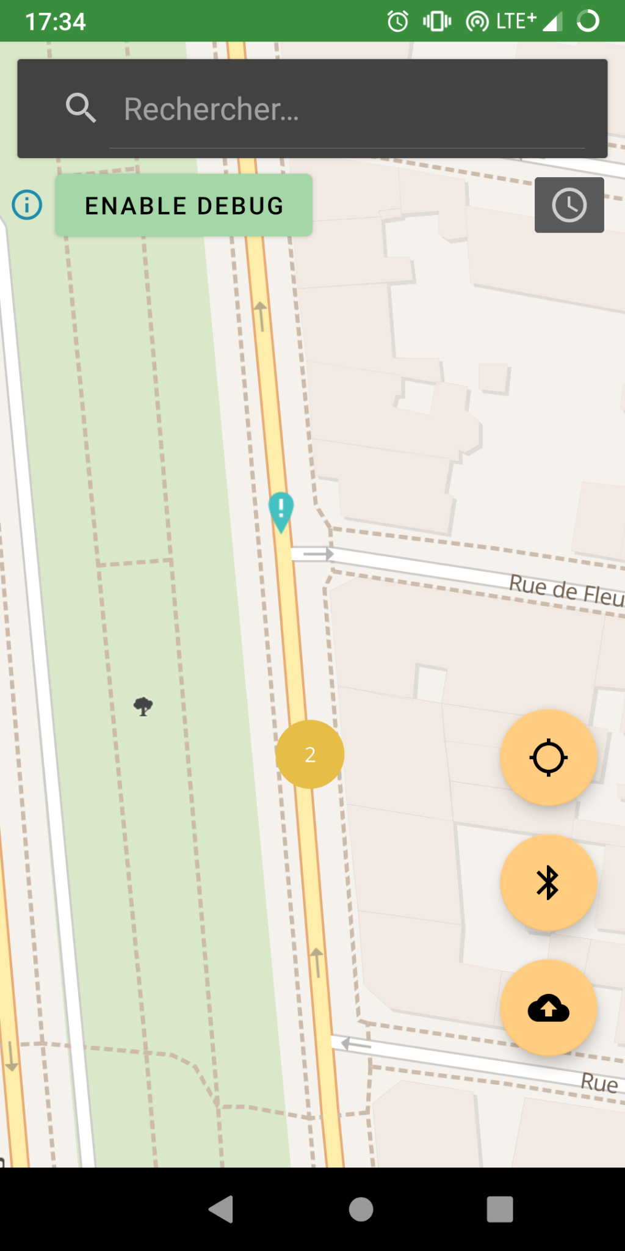
I. General Idea II. General Architecture III. Final Result I V. Conclusion V. Live Demo
Final Result: Application
Arnaud
Android app written in

Slide 19
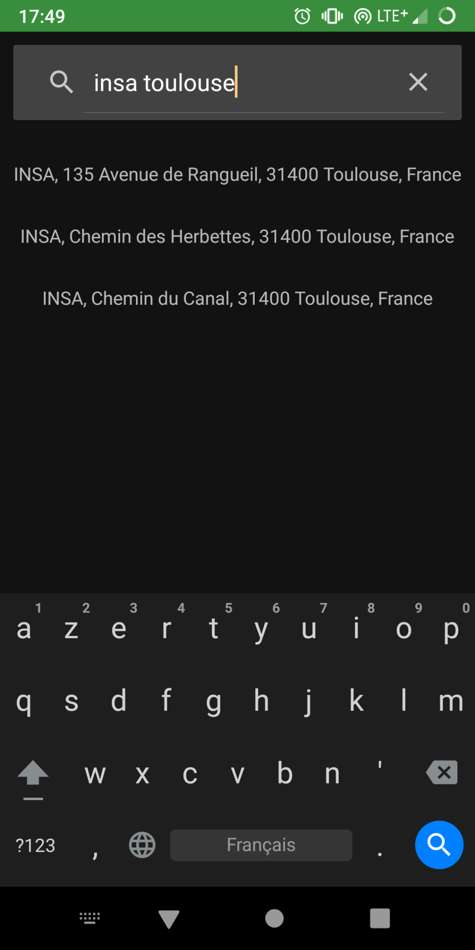
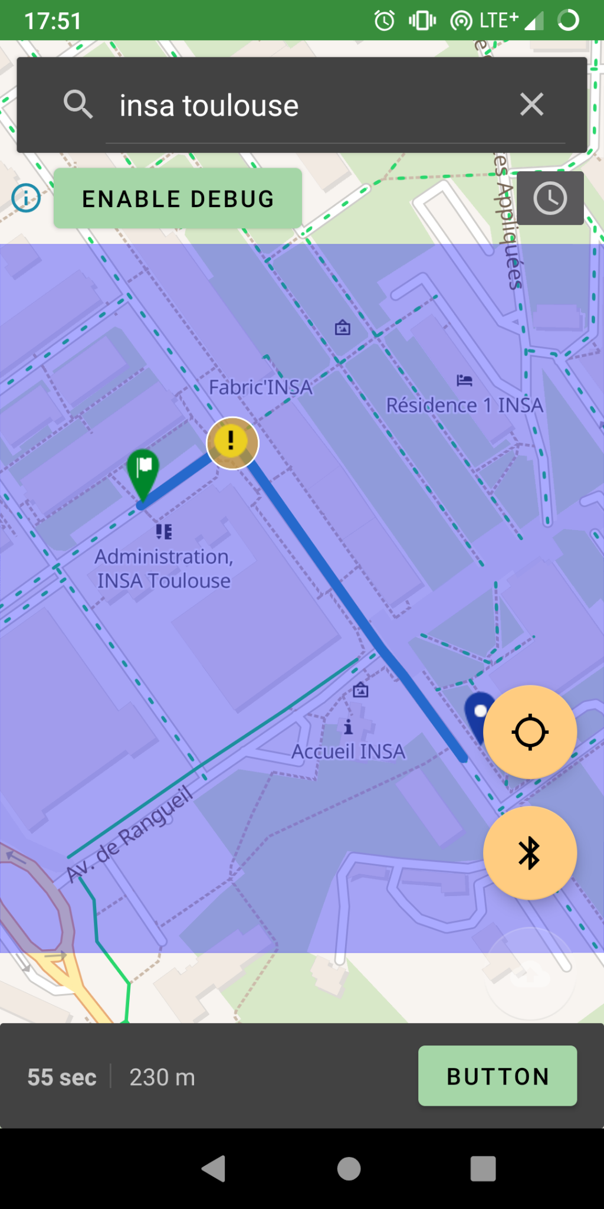
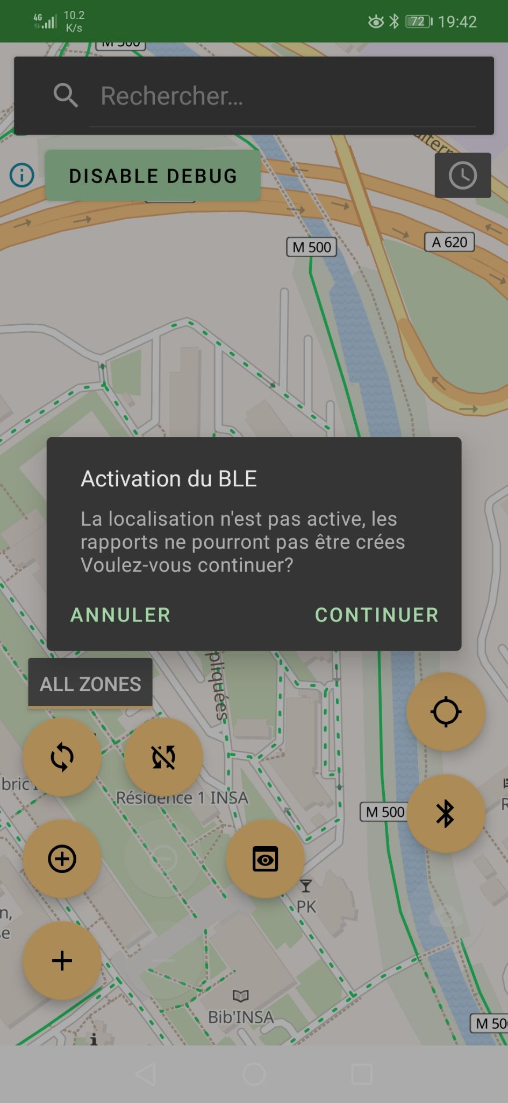
I. General Idea II. General Architecture III. Final Result I V. Conclusion V. Live Demo
Final Result: Application
Arnaud
Android app written in

Slide 20

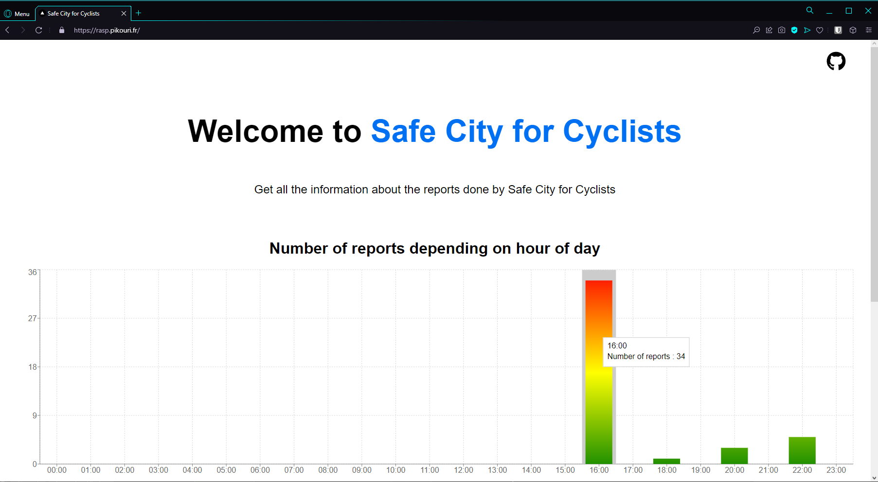



I. General Idea II. General Architecture III. Final Result I V. Conclusion V. Live Demo
Final Result: Server
Jean-Rémy
https://rasp.pikouri.fr
Server written in
Next.js Server backend
React User Interface library
MySQL Database system
Notes:
Domain name : rasp.pikouri.fr
HTTPS
TS
REST API backend + frontend website => Next.js
React UI library for the frontend
Server side rendering => speeds up
access, modify and delete data from database => MySQL database + phpMyAdmin access

Slide 21
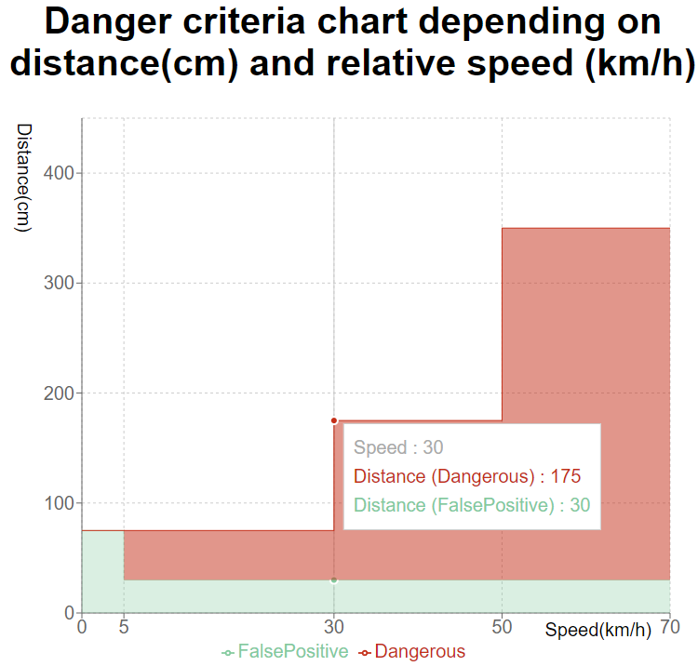
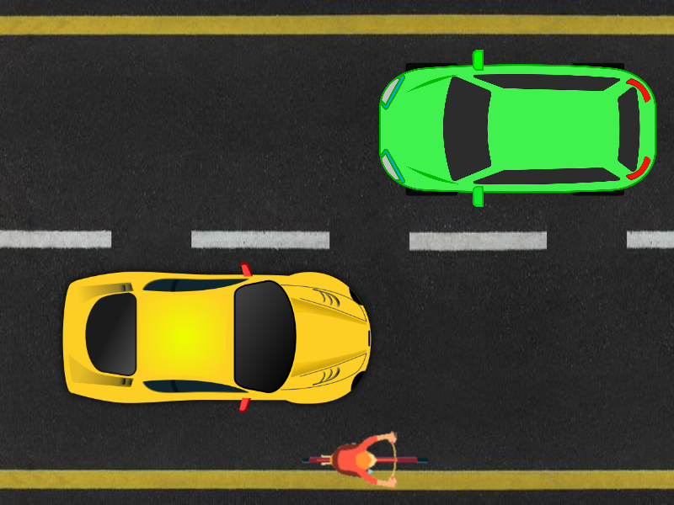
I. General Idea II. General Architecture III. Final Result I V. Conclusion V. Live Demo
Final Result: Server
Jean-Rémy
Server made with
Danger criteria chart depending on distance and relative speed
3
2
1
Notes:
Website => Chart with live data for the users
3 zones :
Really close to the cyclist
2nd zone ends at the middle of the road lane
Road lane
False positive
Easily reconfigurable (REST API)

Slide 22
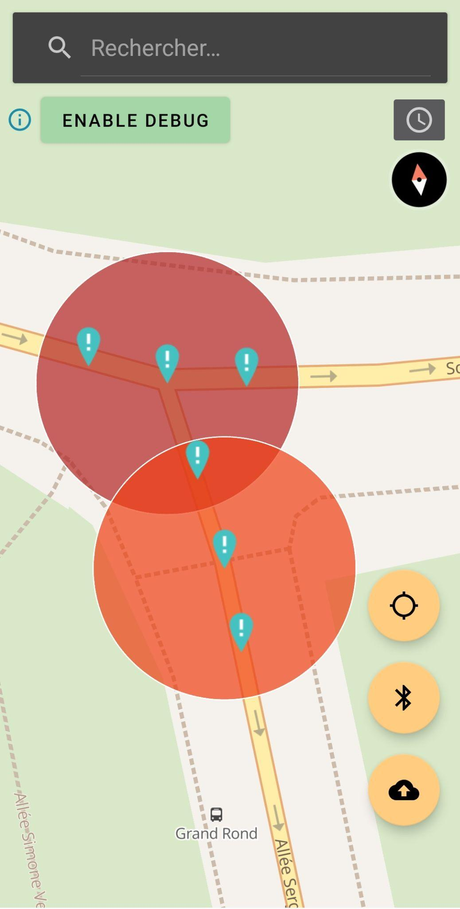
I. General Idea II. General Architecture III. Final Result I V. Conclusion V. Live Demo
Final Result: Server
Jean-Rémy
Server made with
“Custom” Clustering
Simple algorithm
Notes:
Conversion
In order to display a Heatmap
Wanted zones with a defined radius that gather reports that are close to each other

Slide 23
I. General Idea II. General Architecture III. Final Result IV. Conclusion V. Live Demo
Conclusion
Better accuracy
Better energy harvesting
Improve danger criteria
Implement security
Avoid dangerous zones
Notes:
Perspectives:
Avoid dangerous zones
Better accuracy (combined with camera) (data fusion)
Better energy harvesting (solar cell)
Implement security
Tweak danger criteria
Skills:
Learn new technologies (LIDAR, Kotlin, …)
Split work, organize team work

Slide 24
V.LIVE DEMO
Notes:
Démo vidéo
Explication de la démo live
Présentation du vélo
Connexion BLE
Lancement trajet fake gps
Passage avec tableau-voiture devant vélo => Pas de rapport si assez loin
=> Fermeture appli + Changement critères
Repassage tableau-voiture
Affichage données rapports
Upload rapports => n’apparait pas si non dangereux (si possible faire un très proche pour faire apparaître)
Changement d’heure pour afficher différentes heatmaps
Démo site

Slide 25

Notes:
Démo vidéo
Explication de la démo live
Présentation du vélo
Connexion BLE
Lancement trajet fake gps
Passage avec tableau-voiture devant vélo => Pas de rapport si assez loin
=> Fermeture appli + Changement critères
Repassage tableau-voiture
Affichage données rapports
Upload rapports => n’apparait pas si non dangereux (si possible faire un très proche pour faire apparaître)
Changement d’heure pour afficher différentes heatmaps
Démo site

Slide 26
Thank you!
Credits:
Template created with Slidesgo

